Slide 1
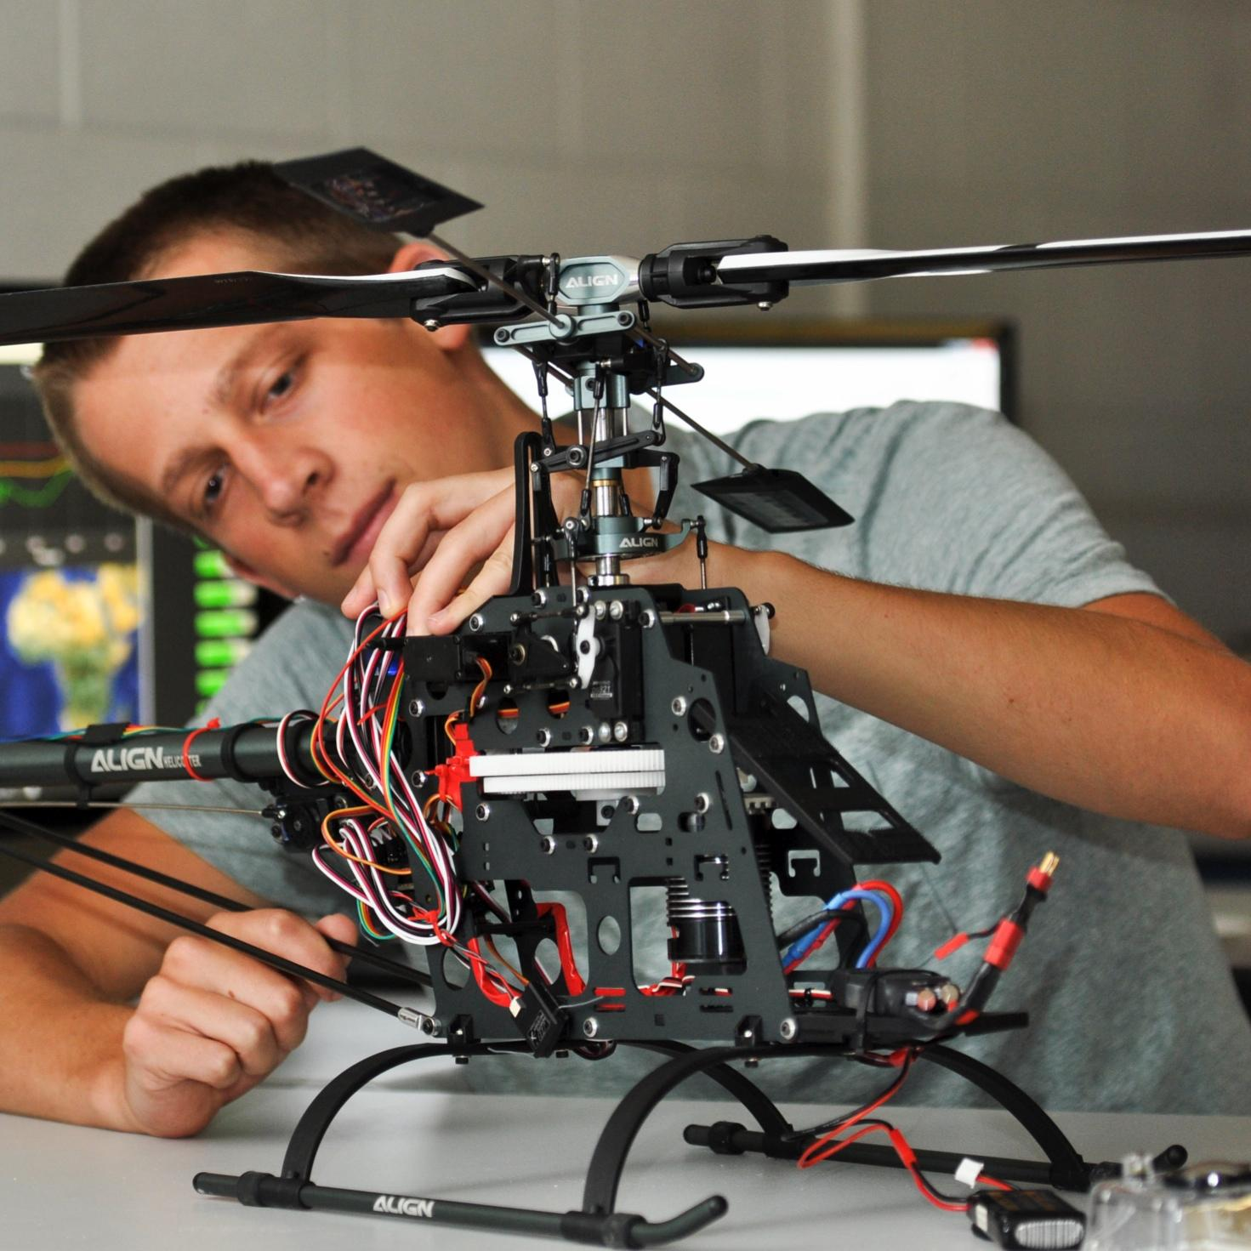

Team 27: Financial Advisor App
for Students
Bi-Weekly Update 1
Camille Embree, Hoang-Nghi Nguyen
Sponsor: Niloofar Borzooei
TA: Sabyasachi Gupta
Notes:
Michelle

Slide 2

Project Summary
Financial management is difficult for many students, with irregular income, high living expenses and a general lack of tools and the incentive to provide clear visibility on personal spending.
Our app addresses this by using AI and machine learning to work with transaction tracking through categorization and personalized financial feedback.

Slide 3
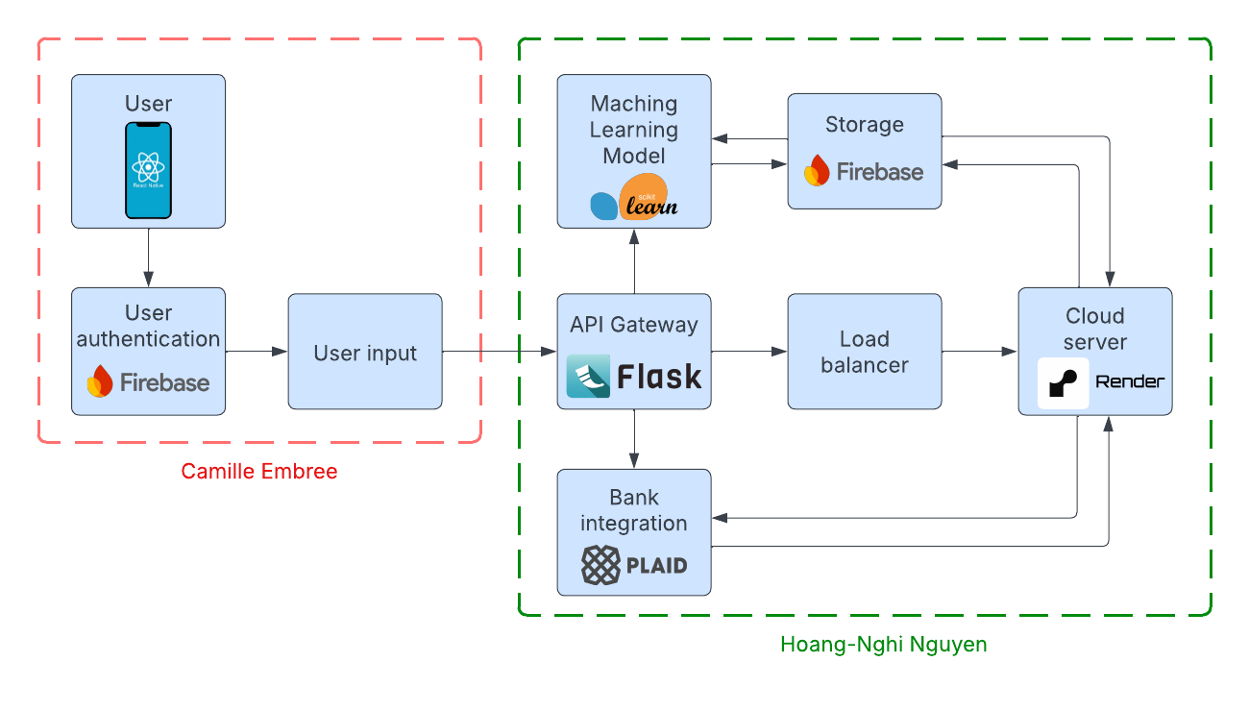
Project/Subsystem Overview

Slide 4
Front-end Subsystem
Camille Embree
Accomplishments since 403 9 hrs of effort | Ongoing progress/problems and plans until the next presentation
Recovered app functionality Switched project to MacBook Solidified database organization | Use IOS laptop to test push notifications Modify UI design to be more soothing Build user survey page upon account creation

Slide 5
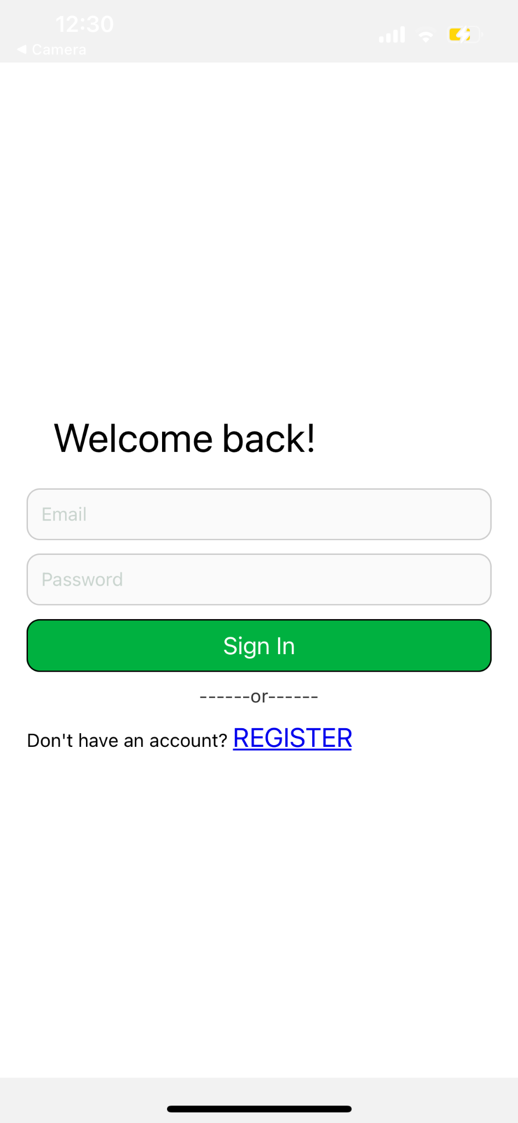
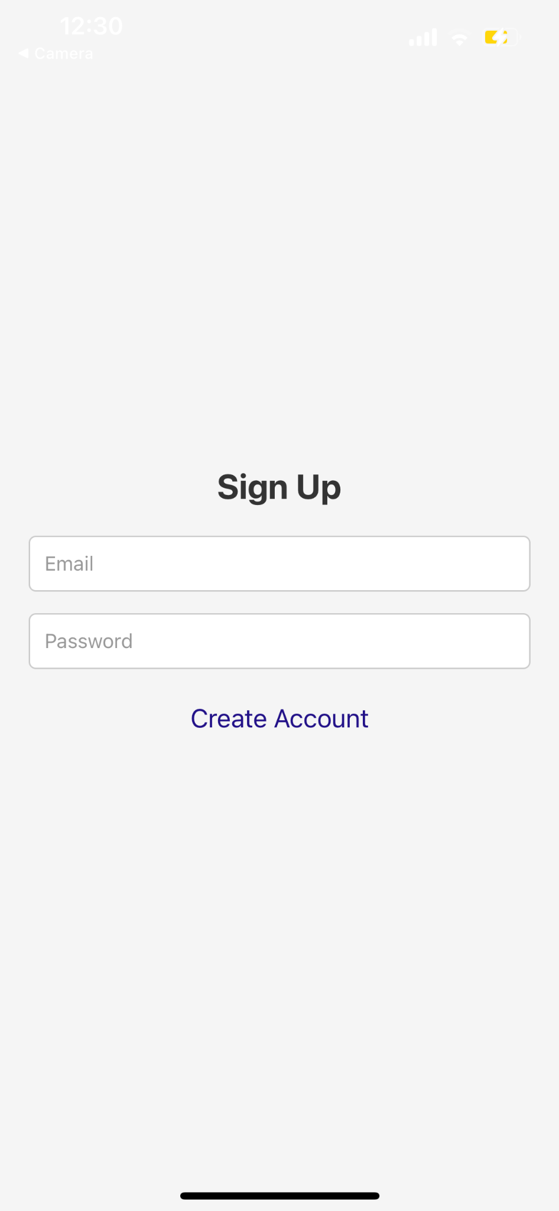
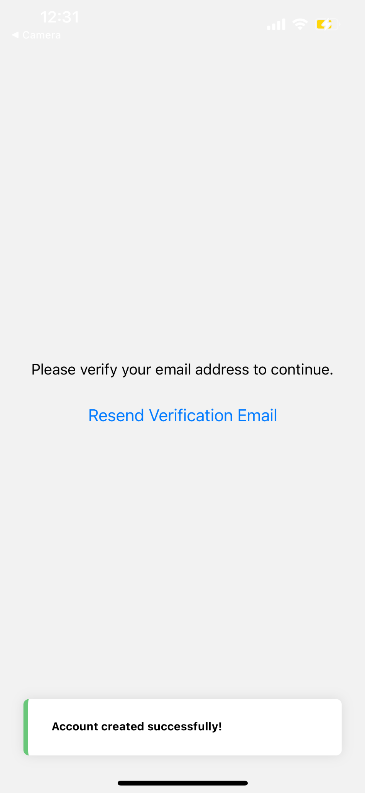
UI Design
Notes:
Design Approach
"Our goal is to make the app easy to use while still providing detailed financial insights.
We’ve focused on a clean layout with a logical flow, ensuring users can quickly access their financial data."
User Interaction
"The design includes features like spending breakdowns, savings goals, and budgeting tools,
all presented in a way that makes financial management approachable rather than overwhelming."

Slide 6
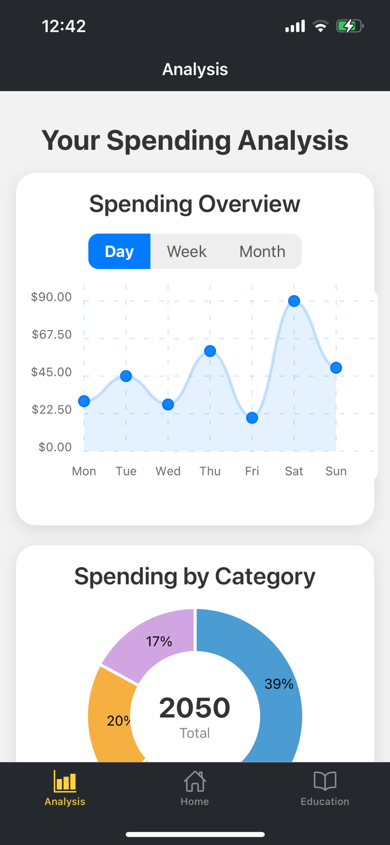
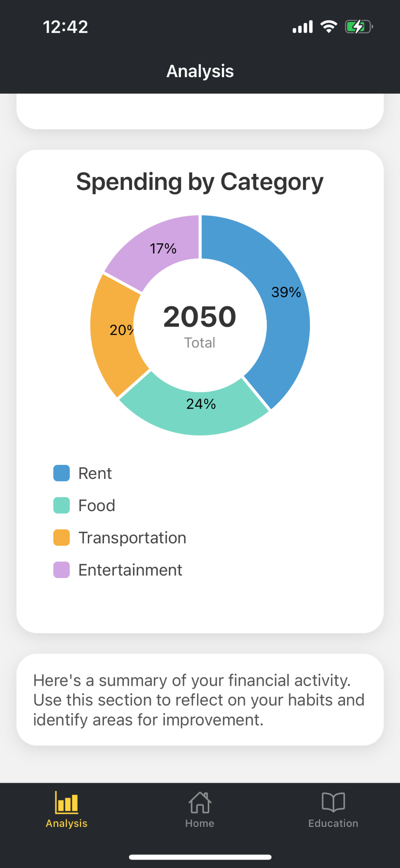
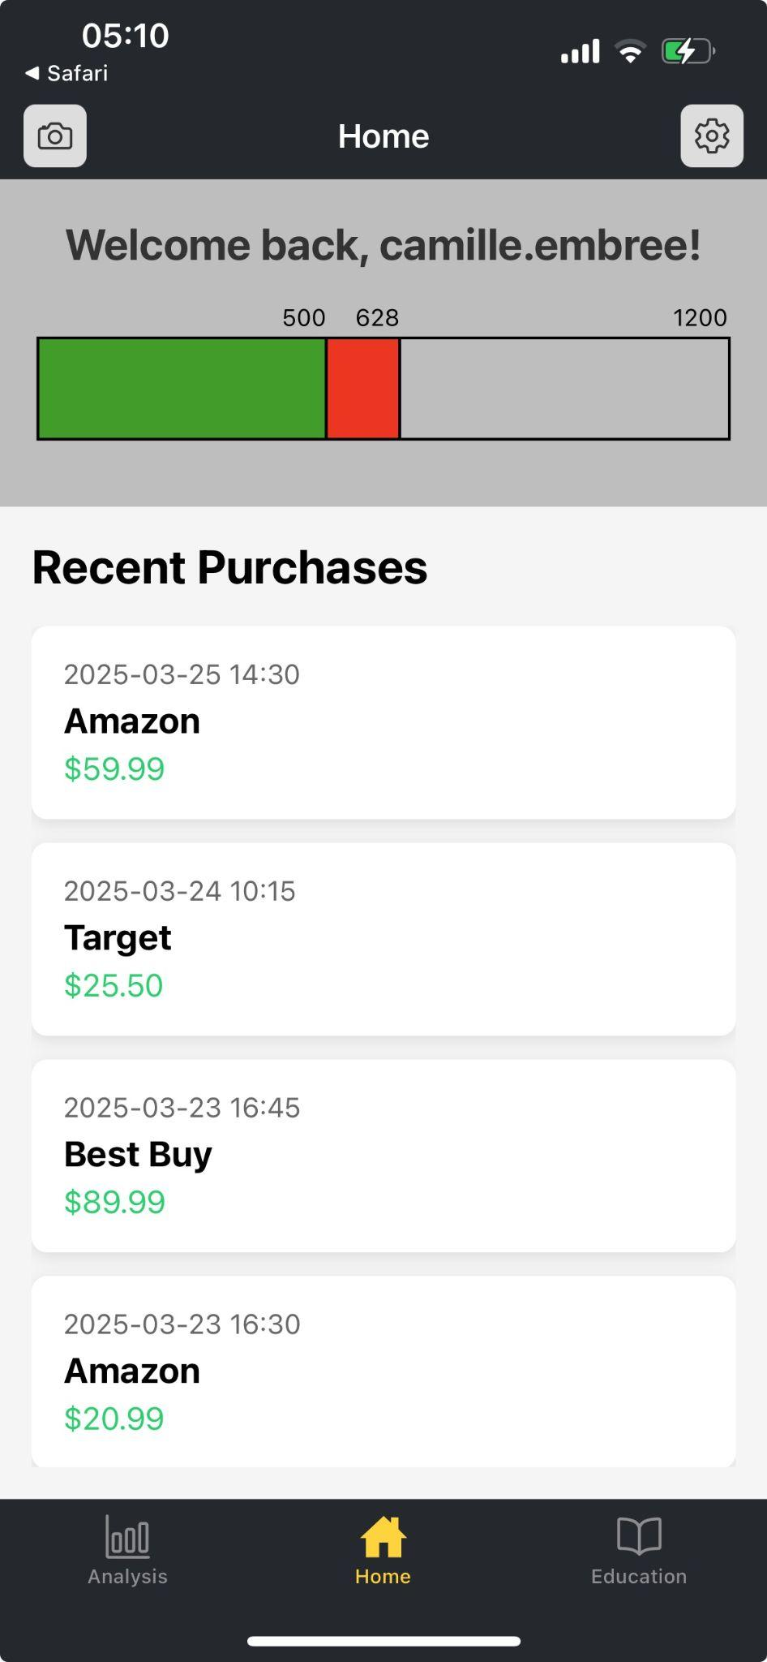
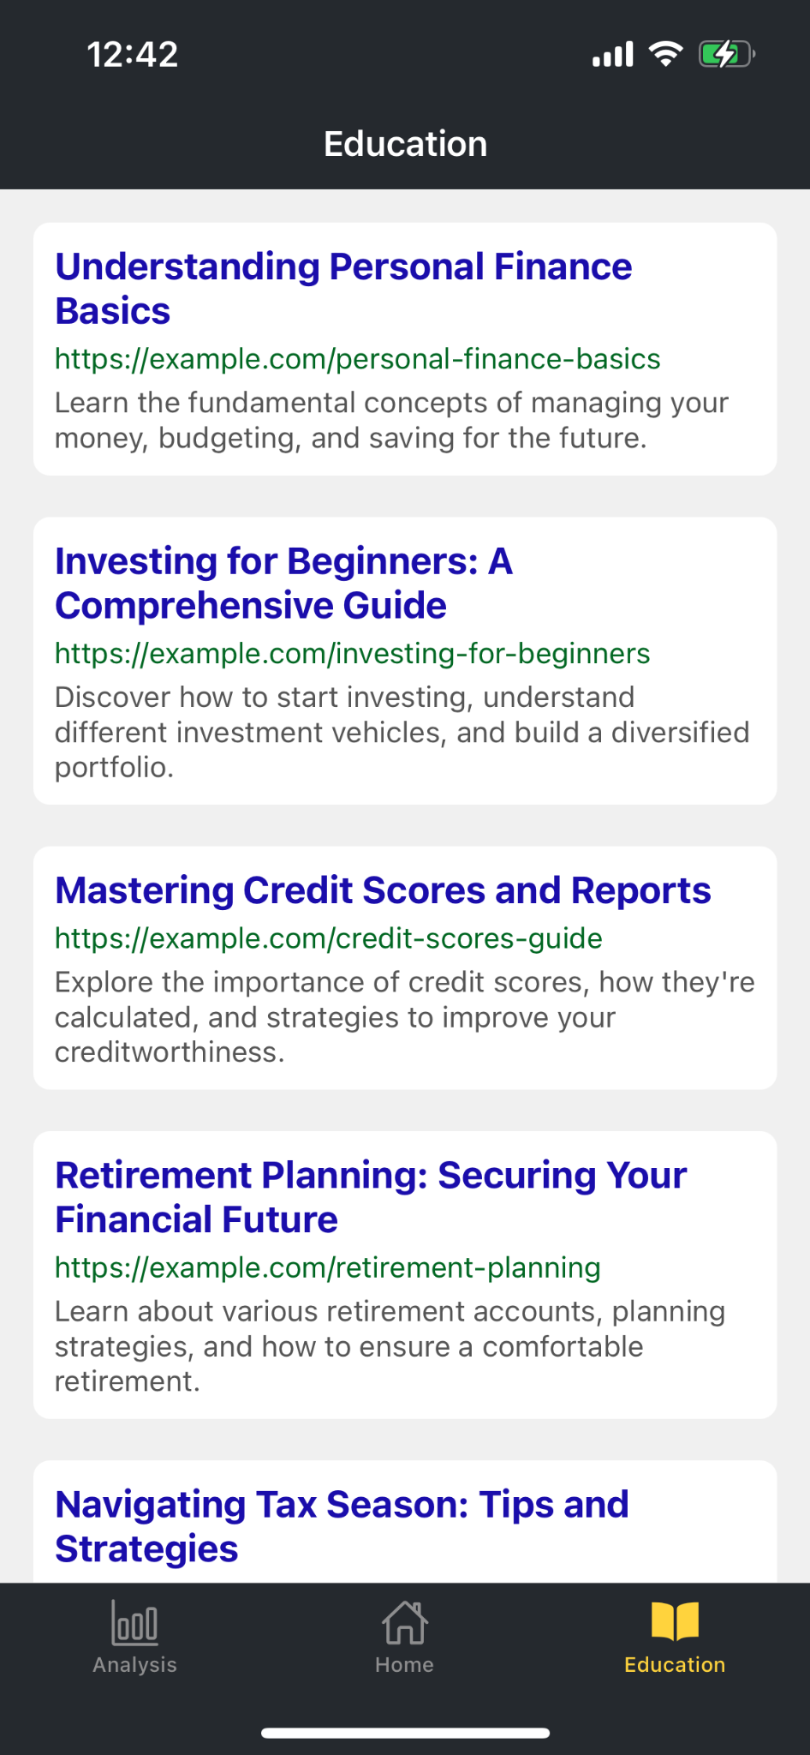
UI Design

Slide 7
Back-end Subsystem
Hoang-Nghi Nguyen
Accomplishments since 403 6 hrs of effort | Ongoing progress/problems and plans until the next presentation
Set up testing environment for Plaid API to acquire user transaction information from bank accounts. | Finalize Plaid API configuration, develop back-end pipeline for bank integration, front-end and back-end connection.

Slide 8
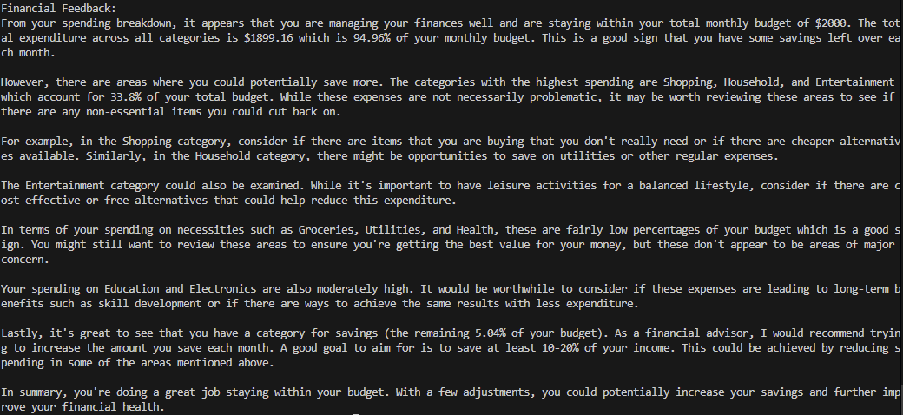
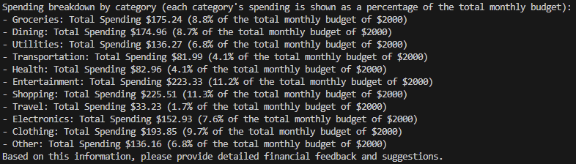
Designed, Tested and Validated

Slide 9
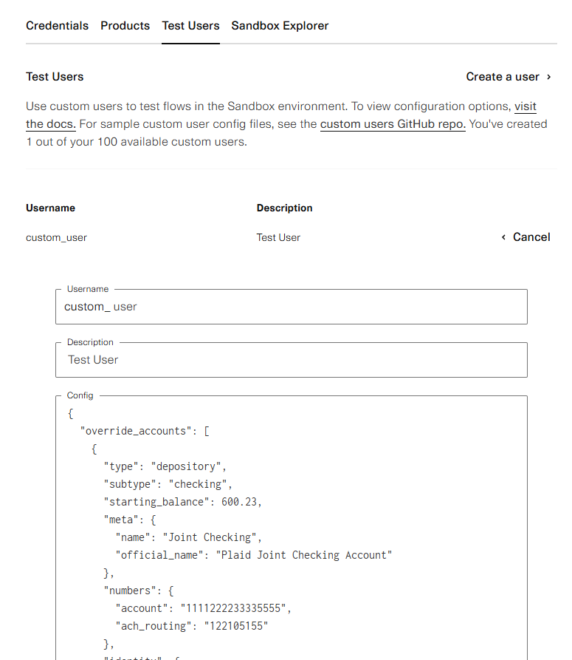
Ongoing progress
Currently running tests on receiving test user data in Sandbox mode.
Formatted in JSON for easy parsing of text from data.

Slide 10
Execution & Plan
 | 2/2/25 | 2/9/25 | 2/16/25 | 2/23/25 | 3/2/25 | 3/9/25 | 3/16/25 | 3/23/25 | 3/30/25 | 4/6/25 | 4/13/25 | 4/20/25 | 9/8/25 | 9/22/25 | 10/20/25 | 11/10/25 | Date
Learn React Native Basics |  |  |  |  |  |  |  |  |  |  |  |  |  |  |  |  | 2/7/25
Design and Plan UI Layout |  |  |  |  |  |  |  |  |  |  |  |  |  |  |  |  | 2/10/25
Install dependencies for Flask (Python) |  |  |  |  |  |  |  |  |  | Not started |  |  |  |  |  |  | 2/10/25
Plan Database Structure in Firebase |  |  |  |  |  |  |  |  |  | In Progress |  |  |  |  |  |  | 2/21/25
Set Up Flask Structure and Environment |  |  |  |  |  |  |  |  |  | Completed |  |  |  |  |  |  | 2/24/25
Set Up Firestore Database |  |  |  |  |  |  |  |  |  | Behind Schedule |  |  |  |  |  |  | 2/25/25
Design Logic for Backend Info Storing |  |  |  |  |  |  |  |  |  |  |  |  |  |  |  |  | 3/14/25
Code general application outline |  |  |  |  |  |  |  |  |  |  |  |  |  |  |  |  | 3/14/25
Integrate Service for Feedback |  |  |  |  |  |  |  |  |  |  |  |  |  |  |  |  | 3/14/25
Set up authentication through Firebase |  |  |  |  |  |  |  |  |  |  |  |  |  |  |  |  | 3/19/25
Set up data sending/fetching to Firestore |  |  |  |  |  |  |  |  |  |  |  |  |  |  |  |  | 3/27/25
Integrate Plaid API for Bank Data |  |  |  |  |  |  |  |  |  |  |  |  |  |  |  |  | 3/26/25
Establish live graph and chart functions |  |  |  |  |  |  |  |  |  |  |  |  |  |  |  |  | 4/2/25
Handle Sign in/Sign up |  |  |  |  |  |  |  |  |  |  |  |  |  |  |  |  | 4/5/25
Integrate Data Management Systems |  |  |  |  |  |  |  |  |  |  |  |  |  |  |  |  | 4/3/25
Implement graph and design home page |  |  |  |  |  |  |  |  |  |  |  |  |  |  |  |  | 4/17/25
Design analysis page |  |  |  |  |  |  |  |  |  |  |  |  |  |  |  |  | 4/12/25
Develop Backend APIs for Records |  |  |  |  |  |  |  |  |  |  |  |  |  |  |  |  | 4/9/25
Finalize Database and Backend Structures |  |  |  |  |  |  |  |  |  |  |  |  |  |  |  |  | 4/18/25
Design education page |  |  |  |  |  |  |  |  |  |  |  |  |  |  |  |  | 4/23/25
Integrate Alerts/Sounds |  |  |  |  |  |  |  |  |  |  |  |  |  |  |  |  | 4/23/25
Join Firestore Database |  |  |  |  |  |  |  |  |  |  |  |  |  |  |  |  | 9/20/25
Modify UI to Include Relaxing Features |  |  |  |  |  |  |  |  |  |  |  |  |  |  |  |  | 10/18/25
Plaid API Integration |  |  |  |  |  |  |  |  |  |  |  |  |  |  |  |  | 10/20/25
Fully integrate Front-end and Back-end Operations |  |  |  |  |  |  |  |  |  |  |  |  |  |  |  |  | 11/10/25

Slide 11
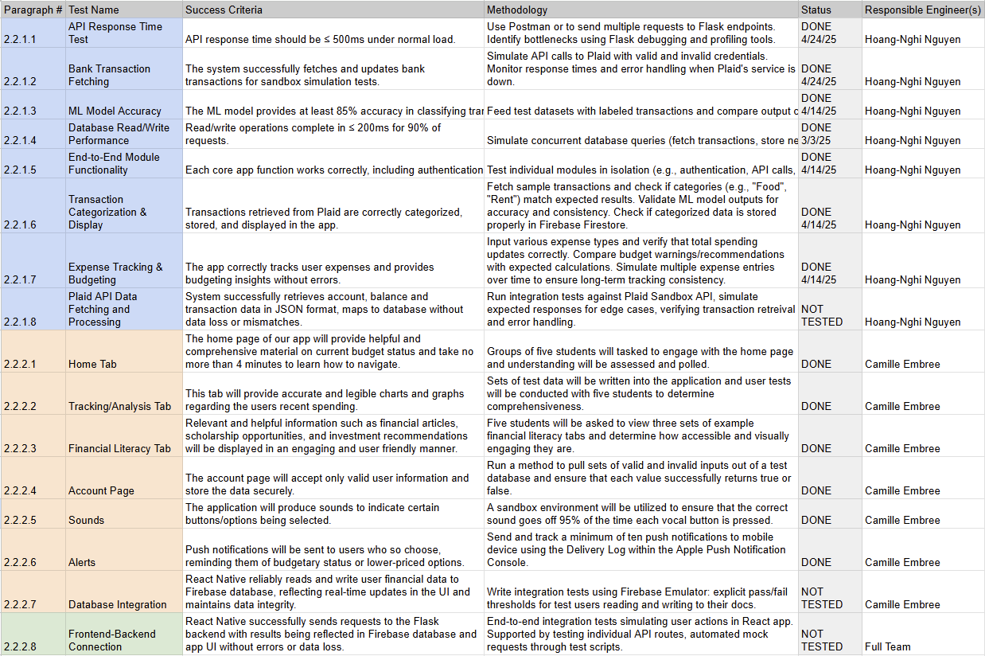
Execution & Plan

Slide 12
Thank you

